Slide 2
what contributes the most to the
calories of the food we eat?
3330 PROJECT
Chen Yutong & Qun Yan

Slide 3
Introduction
Four ways to predict the mode
Compare models to find Final model
Some problems and remedies
Data without outliers for the best model
Some tests
Conclusion

Slide 4
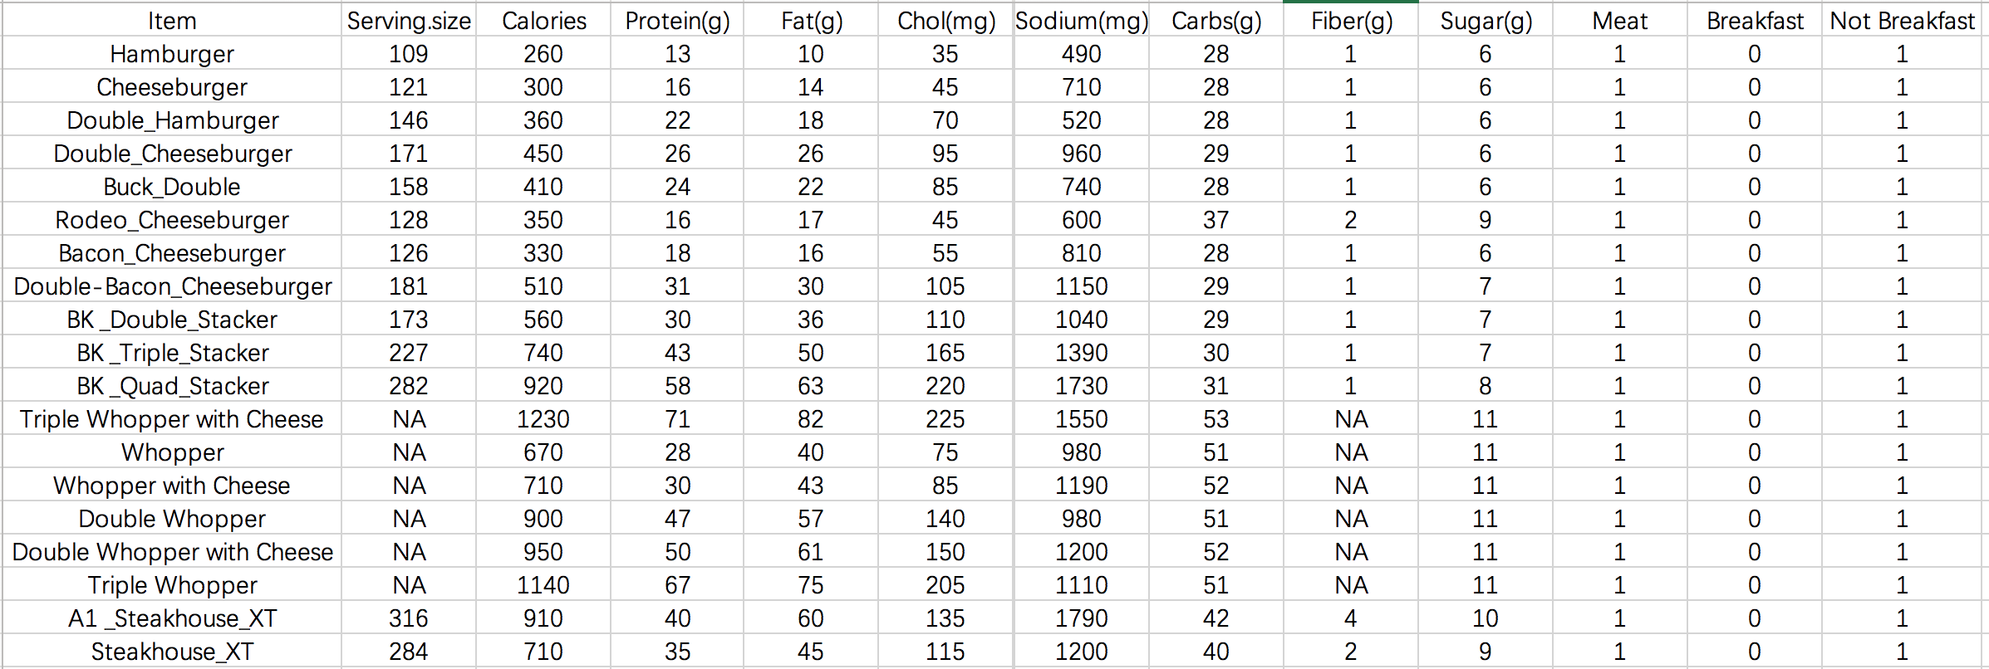
Serving size ?
Calories Protein Fat Cholesterol Sodium Carbs Fiber Sugar Meat
Breakfast or Not Breakfast ?

Slide 5
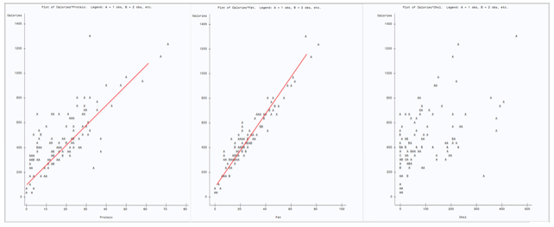
Four ways to predict the mode 1 Create scatter plots to choose important independent variable
Protein fat chol

Slide 6
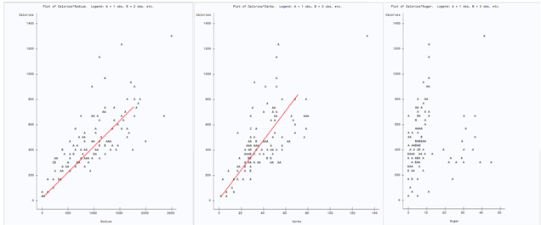
Four ways to predict the mode 1 Create scatter plots to choose important independent variable
Sodium carb sugar

Slide 7
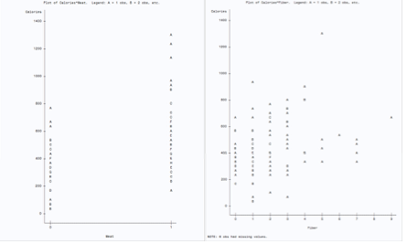
Four ways to predict the mode 1 Create scatter plots to choose important independent variable
Meat fiber

Slide 8
The model we predict from the scatter plots
Calories = β0+β1Fat+β2Carbs+β3Protein+β4Sodium +β5Meat

Slide 9
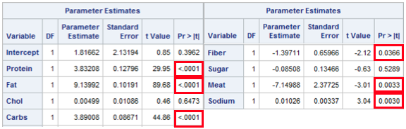
Four ways to predict the mode 2 Compare P-values to find the most significant independent variables

Slide 10
The model we predict from comparing P-values
Calories = β0+β1Fat+β2Carbs+β3Protein+β4Sodium +β5Meat+β6Fiber

Slide 11
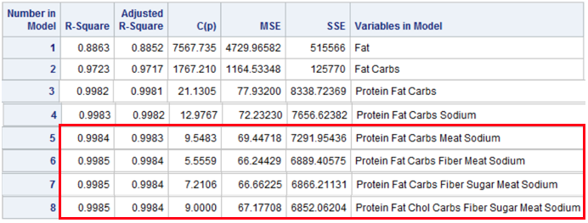
Four ways to predict the mode 3 Model comparison statistics for all reasonable regression model

Slide 12
Four ways to predict the mode 3 Model comparison statistics for all reasonable regression model
Larger R-Square and Adjusted R-Square, smaller C-statistic (closer to the number of parameter, k) and SSE contribute a better model.

Slide 13
Fours model we get from model comparison statistics
Calories = β0+β1Fat+β2Carbs+β3Protein+β4Sodium +β5Meat
Calories = β0+β1Fat+β2Carbs+β3Protein+β4Sodium +β5Meat+β6Fiber
Calories = β0+β1Fat+β2Carbs+β3Protein+β4Sodium +β5Meat+β6Fiber+β7Sugar
Calories = β0+β1Fat+β2Carbs+β3Protein+β4Sodium +β5Meat+β6Fiber+β7Sugar+β8Chol

Slide 14
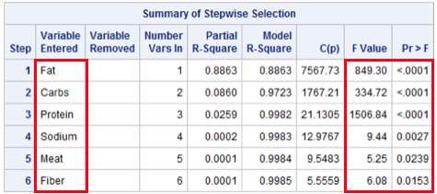
Four ways to predict the mode 4 Stepwise regression

Slide 15
The model we get from Stepwise regression
Calories = β0+β1Fat+β2Carbs+β3Protein+β4Sodium +β5Meat+β6Fiber

Slide 16
Compare models to find Final model
By some standard criterions: R2, SSE and Adjusted R2
By advanced methods: C statistic and the press statistic
PRESS value of each model by SAS and combine it with other criterions in order to compare

Slide 17
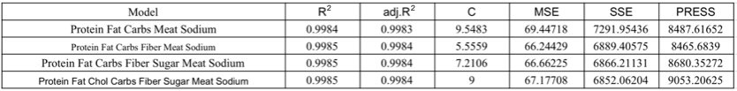
Compare models to find Final model
large R-Square and Adjusted R-Square, small C-statistic (also closer to the number of parameter, k), SSE and PRESS

Slide 18
Second one is the best and our final model
Calories = β0+β1Fat+β2Carbs+β3Protein+β4Sodium +β5Meat+β6Fiber

Slide 19
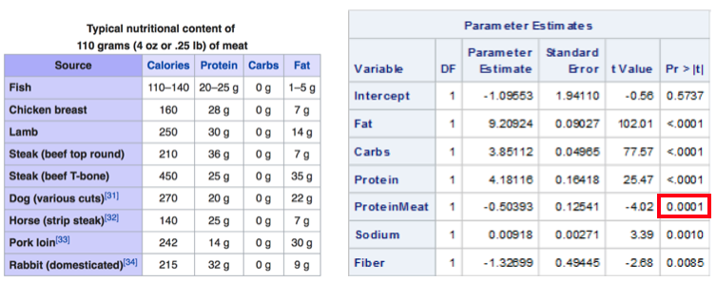
Compare models to find Final model Test the Dummy variable
p-value indicates that the parameter estimate of ProteinMeat is highly significant

Slide 20
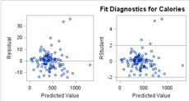
Compare models to find Final model Check patterns for quadratic or intersection
The plots of residual and studentized residual versus predicted value does not show a clear quadratic or intersection pattern

Slide 21
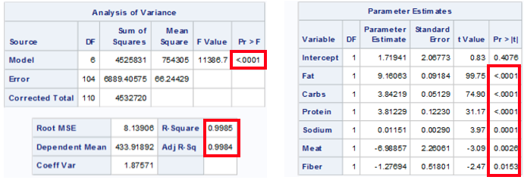
Compare models to find Final model Test the significance of model: R-square, F statistic, P-value
The F statistic for the overall model is highly significant (F =11386, p < 0.0001). It indicates that the model explains a significant portion of the variation in data.
→The R-Square and Adj.R-Square are two statistics used in assessing the fit of the model. Their values are close to 1, indicating a better fit.
→The p-values indicate that the parameter estimates of independent variables are highly significant

Slide 22
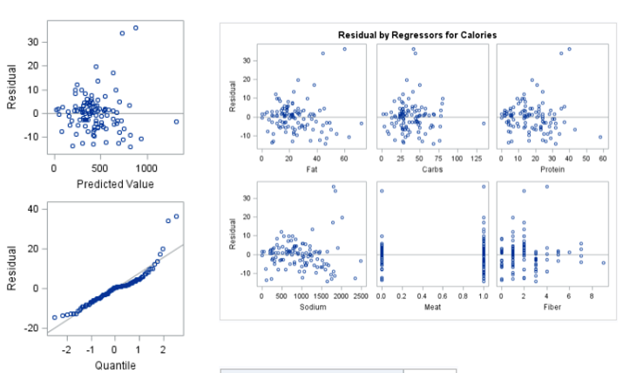
Compare models to find Final model Check the 3 assumptions of εi: constant variance, normality, independent
Constant variance: Residual plot explores no pattern, so constant variance.

Slide 23
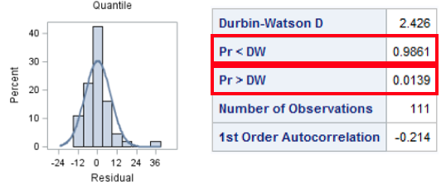
Compare models to find Final model Check the 3 assumptions of εi: constant variance, normality, independent
p-value >0.05,
fail to reject H0;
p-value <0.05,
reject H0
Normal: histogram plot and residual quantile support normal assumption.
Independence:
→Negative Durbin-waston test reject H0. have negative autocorrelation.
→Positive Durbin-waston test do not reject H0. have no positive autocorrelation

Slide 24
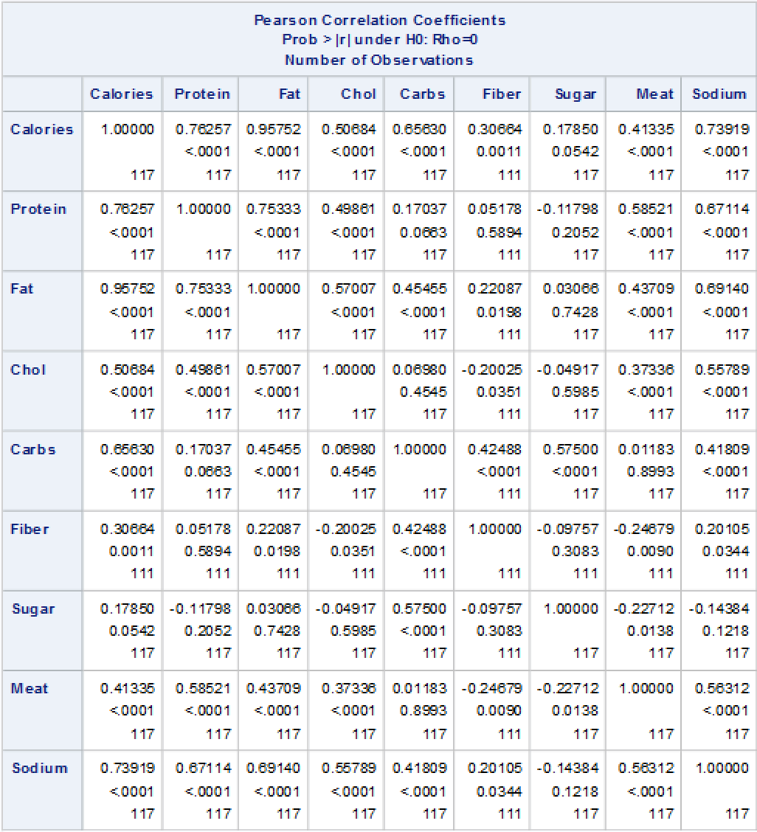
Some problems and remedies 1 Check Multicollinearity: Correlation and variance inflation factor
Correlation table does not show significant large value

Slide 25
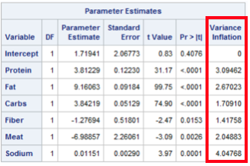
Some problems and remedies 1 Check Multicollinearity: Correlation and variance inflation factor
→The largest Vif is less than 10, and the overall data has no significant large value.
→So there is no significant autocorrelation.

Slide 26
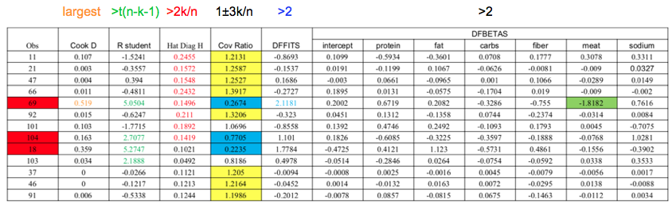
Some problems and remedies 2 Use diagnostic statistics to identify outlying and influential observations

Slide 27
Outliers with respect to x: Obs 11, 26, 47,66, 69, 92, 101, 104
Outliers with respect to y: Obs 18, 69, 103, 104

Slide 28
The difference in fits statistic: Obs 69, removing it will substantially change the prediction of y.
Influential point: Obs 69

Slide 29
The difference in estimate of βi statistic: Obs 69, removing this observation would substantially change the point estimates.
Covariance Ratio:
Obs 11, 21, 37, 46, 47, 66, 91, 92, drop these observations will damage the model, so we keep them;
Obs 69, 104, 18, drop these observations will enhance the model, so we drop them.

Slide 30
Some problems and remedies 3 Analyze some special outlying points
The three outliers we decide to be removed are: Obs 18, 69, and 104, since they influence the model most significantly.
Obs 101 is only the outlier with respect to x, Obs 103 is only the outlier with respect to y, and the Cove Ratio does not identify drop it will damage or enhance the model, so we keep them

Slide 31
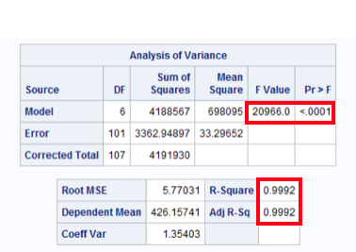
Data without outliers for the best model 1 Retest the significance of the model
The F statistic for the overall model is highly significant (F =20966.0, p < 0.0001). It indicates that the model explains a significant portion of the variation in data.
The R-Square and Adj R-Square are two statistics used in assessing the fit of the model. Their values are close to 1, indicating a better fit.

Slide 32
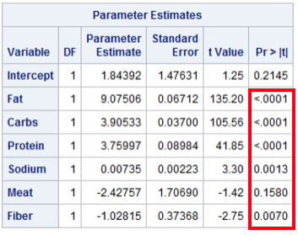
Data without outliers for the best model 1 Retest the significance of the model
Most of the p-values indicate that the parameter estimates of are highly significant, only the Variable Meat has , but since it is a dummy variable the model still good.

Slide 33
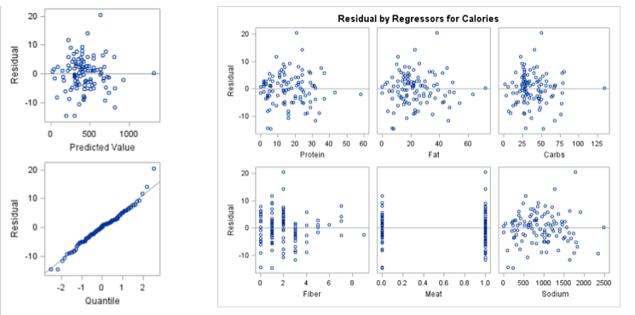
Data without outliers for the best model 2 Recheck the 3 assumptions of ε_{i}
Constant variance: Residual plot explores no pattern, so constant variance

Slide 34
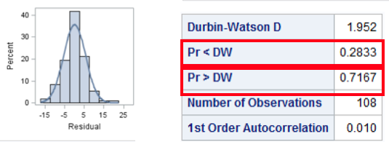
Data without outliers for the best model 2 Recheck the 3 assumptions of ε_{i}
p-value >0.05, fail to reject H0.
p-value >0.05, fail to reject H0.
Independence: Durbin-waston tests do not reject H0. No significant
autocorrelation.
Normal: histogram plot and residual quantile support normal
assumption.

Slide 35
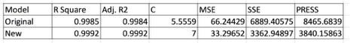
Data without outliers for the best model 3 Compare C statistic, press statistic and SSE with the original model
All the criterions improved after removing outliers, the model become better.

Slide 36
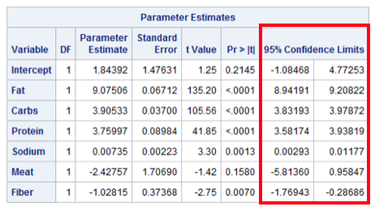
Some tests 95% CI for estimated parameters, expected value, predicted value of y
95% CI for estimated parameters: we are 95% confidence that the Confidence Interval constructed contain the true βi.
These the regions that contain the true βi.

Slide 37
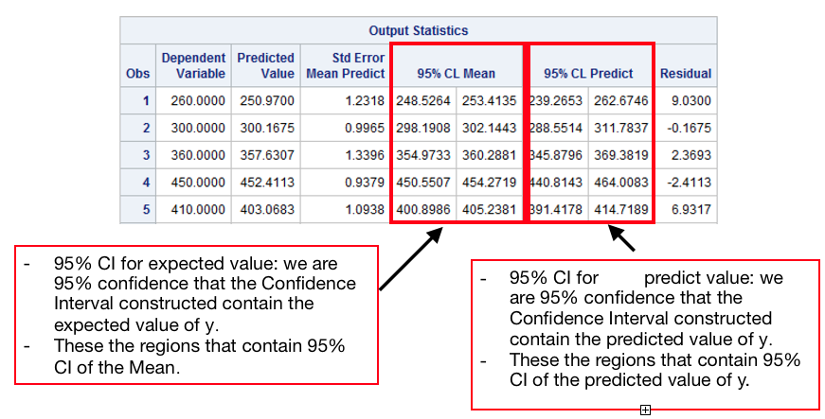
Some tests 95% CI for estimated parameters, expected value, predicted value of y

Slide 38
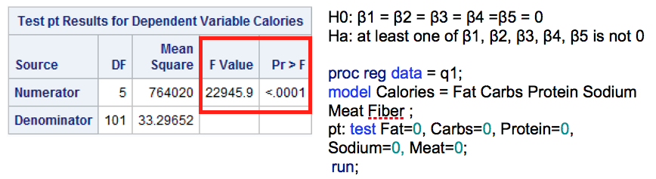
Some tests Partial F-test
P-value<.0001< α=0.05 => reject H0, hence at least one of the independent variables in the collection being tested contribute significantly to a model already containing the other variable.

Slide 39
Conclusion
We found the best model to exam which nutritions cause the calories of foods depends on the data from The Burger King.
The data shows that three of the independent variables: Protein, Fat, Carbs have the most significant relationship with the dependent variable, Calories.

Slide 40
This result is in accord with the existing experimental facts and the material we searched
(Protein, Fat, and Carbs are three major energy consumptions for the human body)

Slide 41
Thank you for listening!

